Slide 1
Asbestos measurement techniques, monitoring ambient and indoor air using SEM, methods and results of a first international PT scheme.
Authors/presenter: R. Koenig, APC GmbH, Eschborn, Germany;
L. Davies, HSL, Buxton, Great Britain;
N. Hoefert, VDI, Düsseldorf, Germany;
Jan Tempelman, TNO, Utrecht, Netherlands

Slide 2
ISO 14966 / VDI 3492
The above mentioned guidelines (with some modifications) using Scanning Electron Microscope (SEM) based measurement methods are widely used
for the determination
of the asbestos fibre concentration in indoor and ambient air in Germany and to some extent in some of its neighboured European countries

Slide 3
PT Schemes
The results of measurements of the asbestos fibre concentration are used to make decisions, which may result in financial and economical consequences, in addition to the health effects of workers and others.

Slide 4
PT Schemes
As a result it is critical, that laboratories operating in this field are giving comparable results. It is therefore surprising, that -with the exception of two round robins in Germany during the 1990’s - no regular PT scheme is available for this technique.
APC GmbH 2011

Slide 5
PT Schemes
The main reason for this is the technical difficulty of producing large numbers of filters each with equivalent fibre densities, in a suitable concentration range and at a reasonable cost.
APC GmbH 2011

Slide 6
PT Schemes
To address this problem a small consortium of interested parties was formed (namely APC and VDI in Germany, TNO in the Netherlands and HSL in the UK), with the remit of developing a suitable SEM PT scheme.
APC GmbH 2011

Slide 7
ISO 14966 PT Scheme
From the beginning we were aiming for an international acceptable scheme, therefore the basis was ISO 14966,
being also very similar to VDI 3492 and other SEM methods
APC GmbH 2011

Slide 8
ISO 14966 PT Scheme
The intention was to produce a larger number of equally loaded filter cassettes
with fibre concentrations up to
50 fibres / mm² filter area.
The sample set for the participants shall include at least three filter cassettes having different qualities both in fibre number and asbestos type on the filter.
APC GmbH 2011

Slide 9
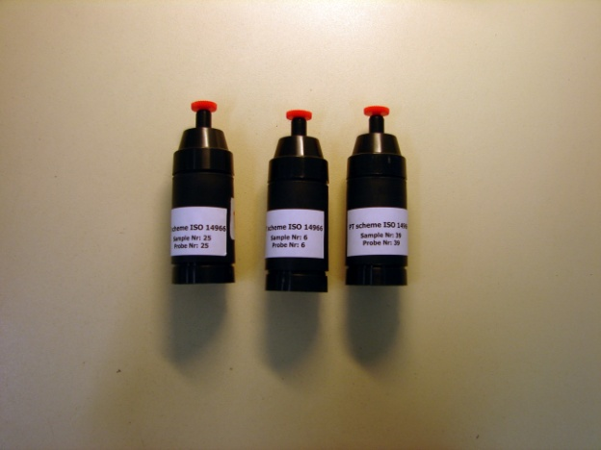
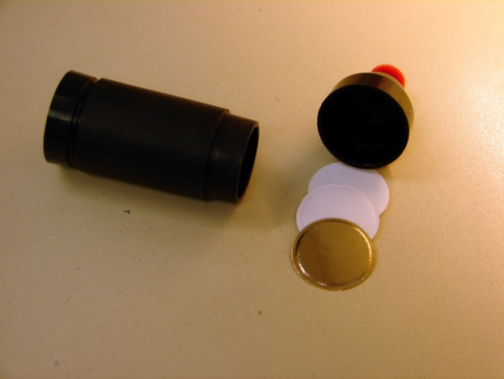
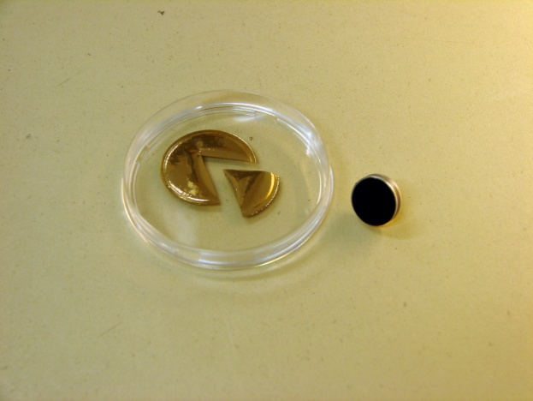
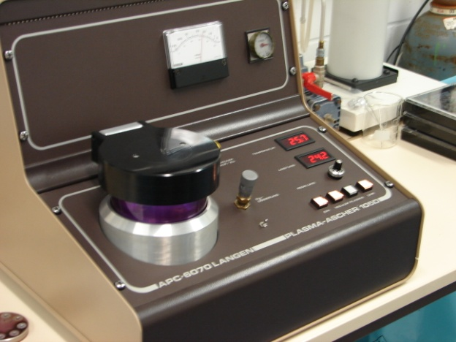
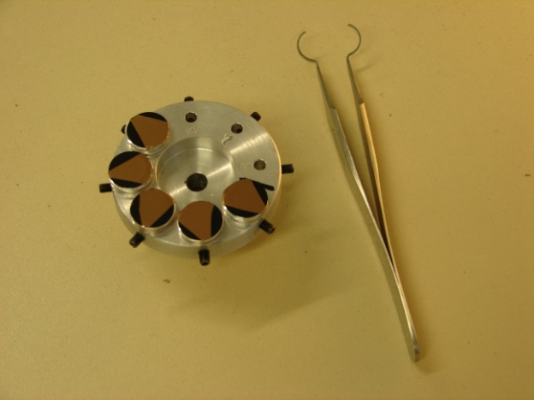
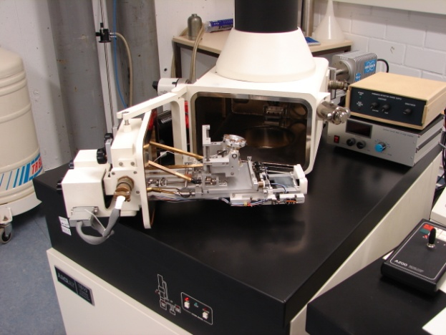
ISO 14966 PT Scheme
(steps included)
APC GmbH 2011

Slide 10
ISO 14966 PT Scheme
(production of loaded filter cassettes)
Sample production is achieved by HSL using a combination of a modified dustiness tester to generate airborne fibre concentrations and a multi-port sampling device – the “Sputnik”.
A combination of commercial asbestos containing materials and specially prepared spiked materials was the source for generating the dust for the filter loading
APC GmbH 2011

Slide 11
ISO 14966 PT Scheme
(production of loaded filter cassettes)
Using a critical orifice and a sampling flow rate of around 1.8 litres per minute, the “sputnik” has the capability to collect up to 114 equally loaded filters (mounted in cassettes), in one batch.
In the first pilot PT scheme two differently loaded filters were used together with an ambient air filter generated by parallel sampling at the same location.
APC GmbH 2011

Slide 12
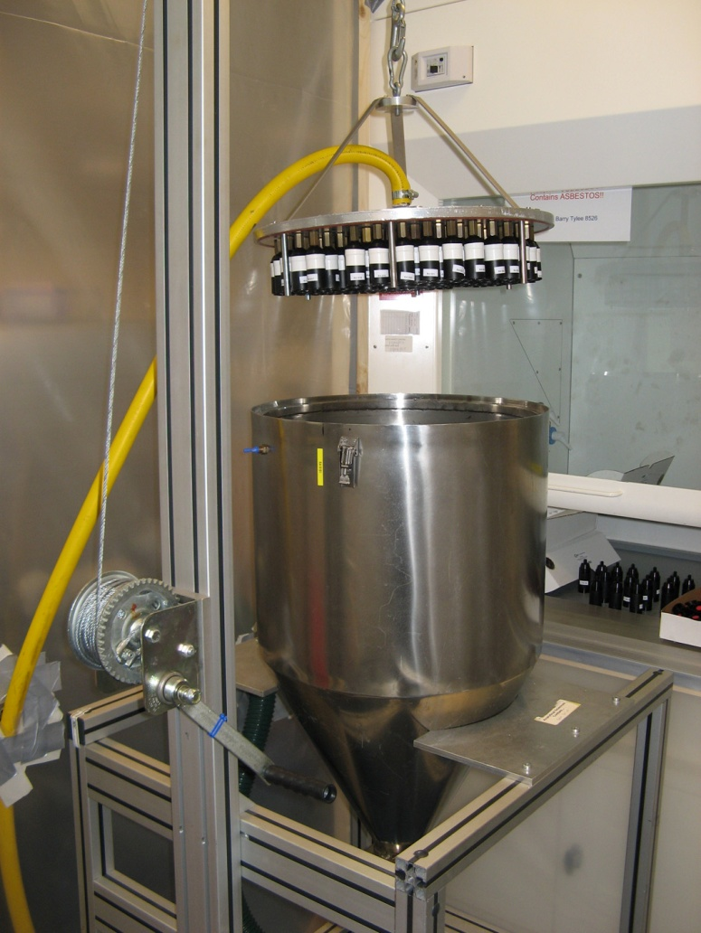
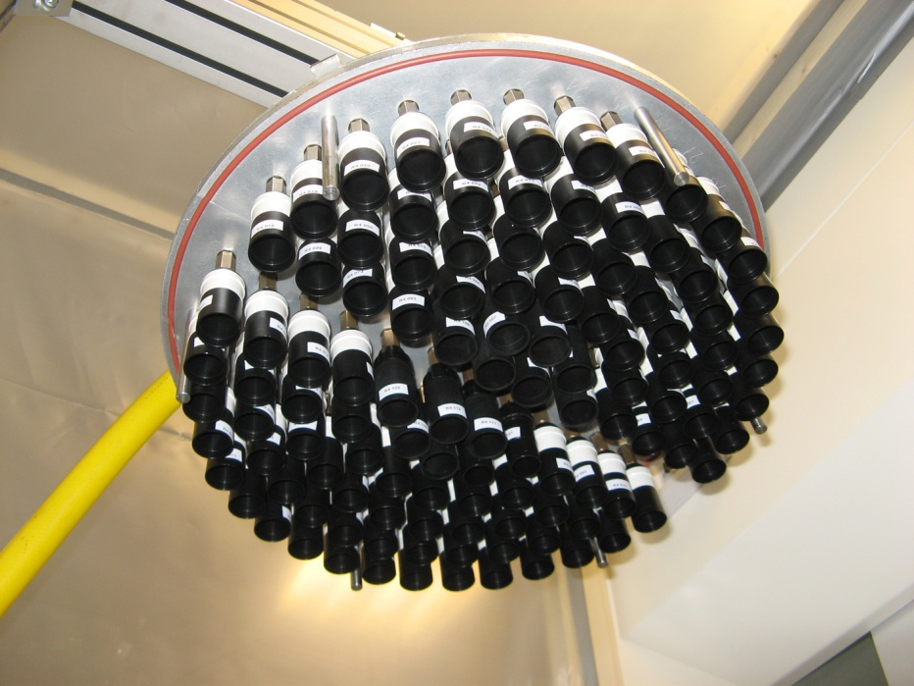
ISO 14966 PT Scheme
(production of loaded filter cassettes)
APC GmbH 2011

Slide 13
APC GmbH 2011

Slide 14
ISO 14966 PT Scheme
Additional Information Package
An additional information package
was sent together with the samples, to ensure with other things, that the counting rules are well understood. Most people use WHO counting rules in their every day business, which are different in some cases from ISO counting rules
APC GmbH 2011

Slide 15
Pilot PT Scheme ISO 14966
During this first trial the number of participants was limited to 15 laboratories, representing five European countries (Austria, Germany, Great Britain, Netherlands and Switzerland).
APC GmbH 2011

Slide 16
Pilot PT Scheme ISO 14966 Results Fibre numbers (L > 5 µm)
Laboratory | Ambient air |  | R 24 |  | R 25 |  | Evaluated filter area mm²
 | Other In. | Asbestos | Other In | Asbestos | Other In. | Asbestos
A | 22 | 0 | 1 | 6 | 22 | 30 | 1,05
B | 0 | 0 | 0 | 10 | 0 | 32 | 1,04
C | 8 | 0 | 3 | 6 | 2 | 31 | 1,03
D | 5 | 0 | 0 | 7 | 2 | 22 | 1,01
E | 3 | 0 | 0 | 11 | 1 | 42 | 1
F | 0 | 0 | 4 | 13 | 11 | 18 | 1
G | 0 | 0 | 0 | 10 | 0 | 18 | 1
H | 1 | 0 | 1 | 3 | 0 | 16 | 1,01
I | 7 | 1 | 0 | 9 | 5 | 38 | 1
K | 0 | 0 | 0 | 5,3 | 0 | 12,9 | 1,7
L | 0 | 0 | 0 | 5 | 0 | 24 | 1,01
N | 0 | 0 | 0 | 8 | 1 | 14 | 1,01
O | 0 | 0 | 0,5 | 2,7 | 0 | 7,7 | 1,83
P | 11 | 0 | 3 | 8 | 1 | 36 | 1
Q | 1 | 0 | 1 | 9 | 0 | 26 | 1
green numbers: calculated for 1 mm² evaluated filter area
APC GmbH 2011

Slide 17
APC GmbH 2011

Slide 18
Pilot PT Scheme ISO 14966
Asbestos varieties in the sample:
50 % crocidolite
45% amosite
5% chrysotile
APC GmbH 2011

Slide 19
Pilot PT Scheme ISO 14966
Results
Observed Deviations:
In a simple estimation the deviation S_{R} resulting from the evaluation by the participants extending the unavoidable poissonian random variation S_{P} can be calculated:
where S_{N} is the standard deviation of the counting results for one filter type
APC GmbH 2011

Slide 20
Pilot PT Scheme ISO 14966
Results
Observed deviations in between-laboratory comparison:
For the ambient air filters no deviation extending the poissonian uncertainty detectable
For the filter type R 24 the variation S_{R}, which results from the between-laboratory comparison of the fibre counts is: appr. 10% relative
For R 25 the variation S_{R} is appr. 30% relative
APC GmbH 2011

Slide 21
Pilot PT Scheme ISO 14966
Results
Detected reasons for the observed variations:
Laboratories with a tendency to be lower than average (asbestos) show two types of discernable deviations:
Smallest detected fibre diameter is 0,3 µm or greater according to their fibre counting form.
or
they record a larger amount of fibres with “no spectra” = unidentified objects
APC GmbH 2011

Slide 22
Pilot PT Scheme ISO 14966
Results
Reasons for the observed variations:
Optimization of EDXA instruments
required:
Greater channel width (20 eV or even more) gives
maximum P/B in shortest possible measurement time and is especially important for the analysis of very thin fibres, to minimize statistical uncertainties in the spectra and to reduce the adverse effects of beam drift during analysis.
APC GmbH 2011

Slide 23
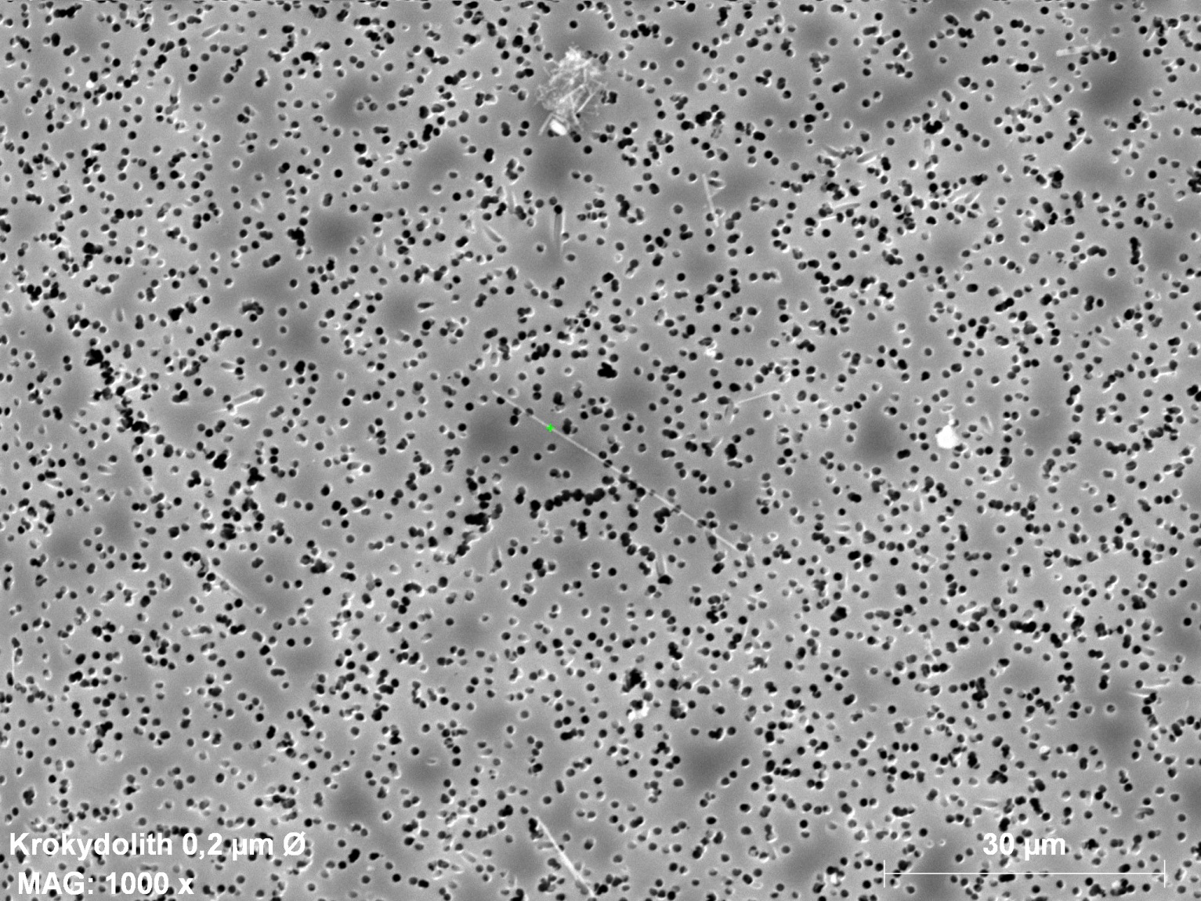
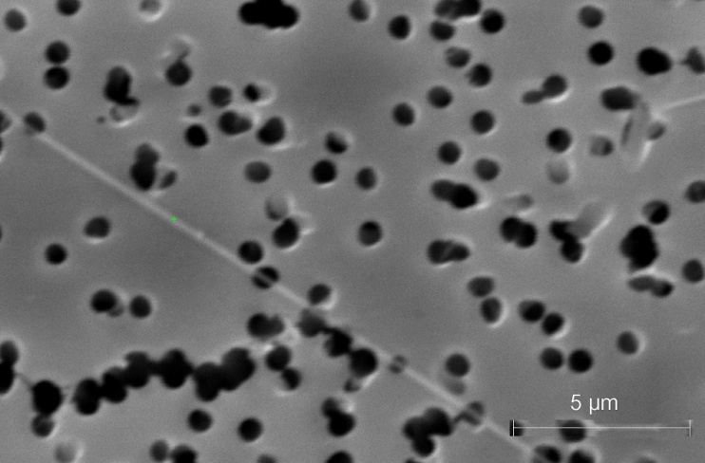
ISO 14966
Optimization of EDXA instruments required:
APC GmbH 2011

Slide 24
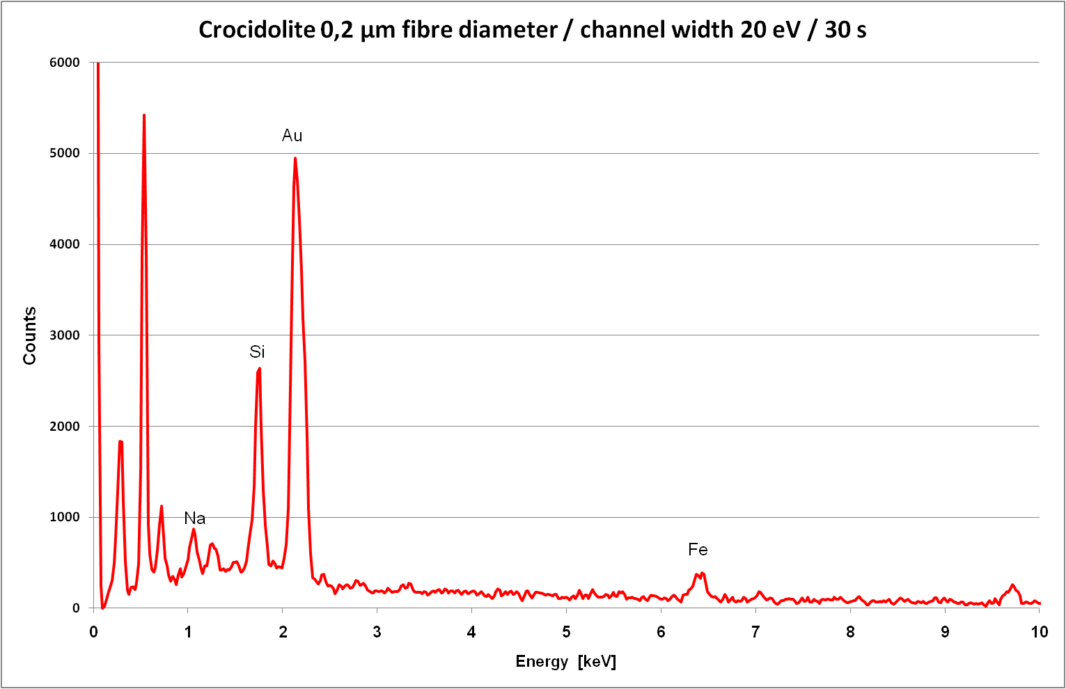
Optimization of EDXA instruments
APC GmbH 2011

Slide 25
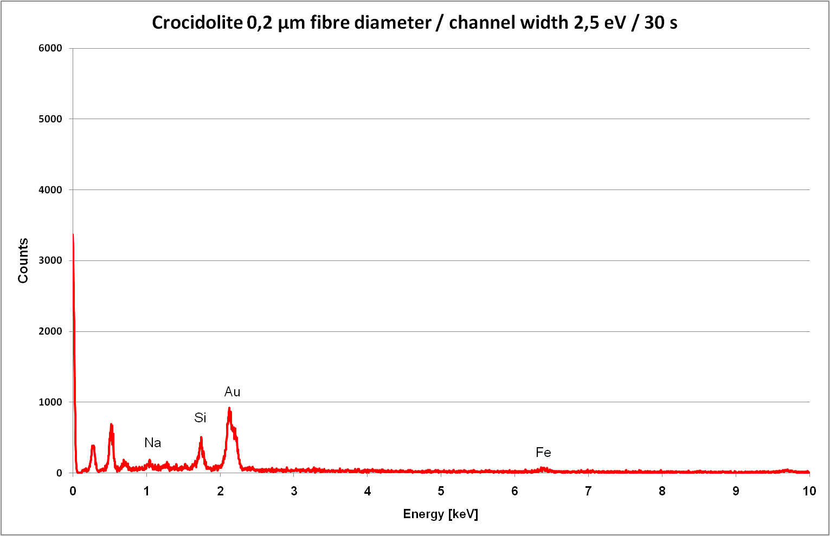
Optimization of EDXA instruments
APC GmbH 2011

Slide 26
Pilot PT Scheme ISO 14966
Summary
The pilot PT scheme was running as scheduled
For a first PT scheme including both preparation
and analysis of the filter samples
the results can be regarded as good, especially in the range of the decision limits (clearance levels as an example) in Germany and some of its neighbored countries.
Based on the experience HSL (Health and Safety Laboratory) will offer a full scale PT scheme starting out later this year.
APC GmbH 2011

Slide 27
Thank you for your attention !

